Slide 1
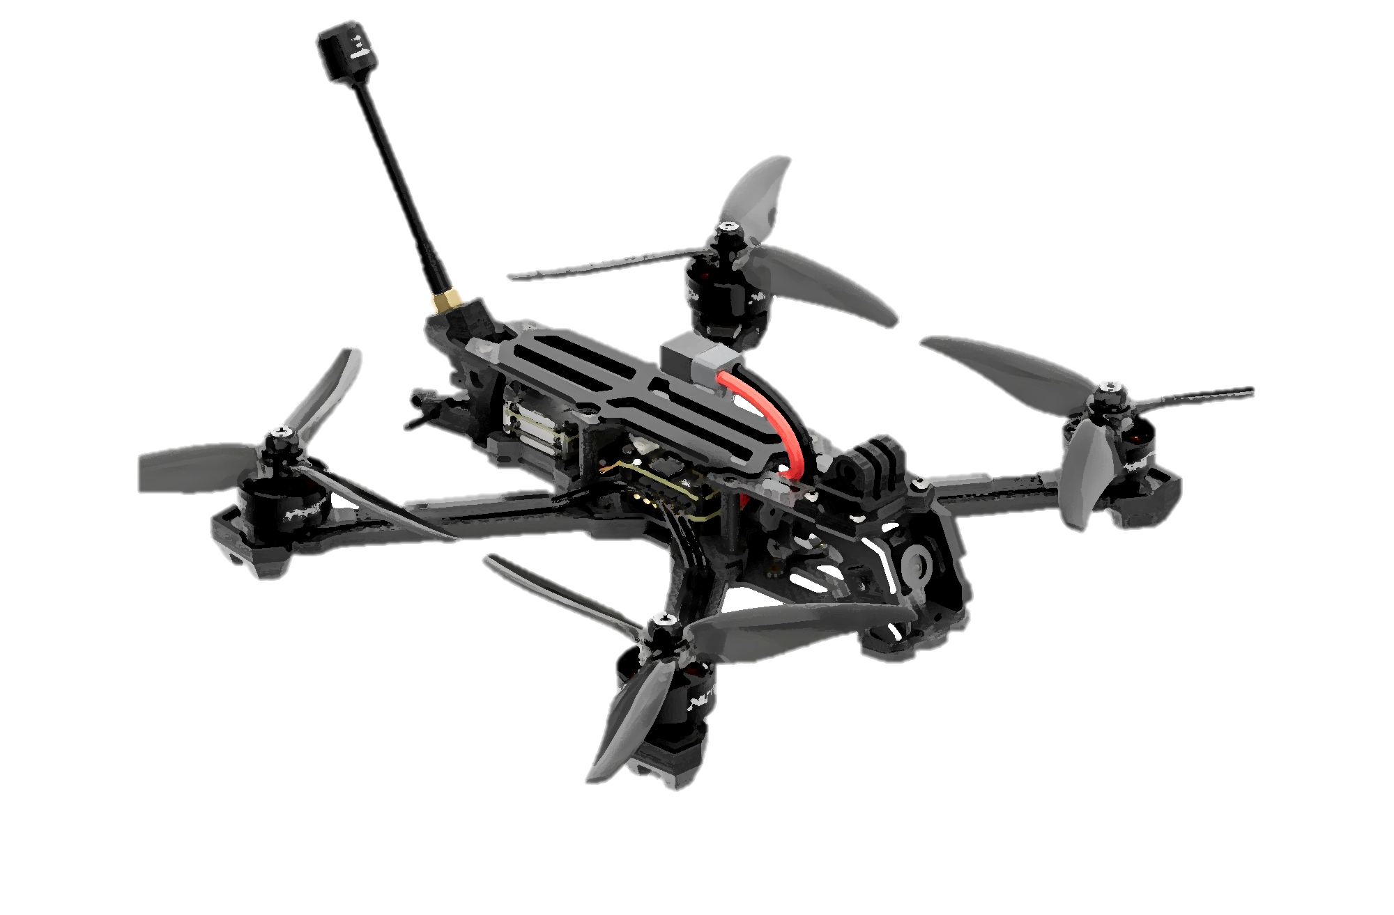
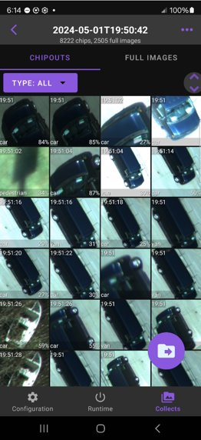
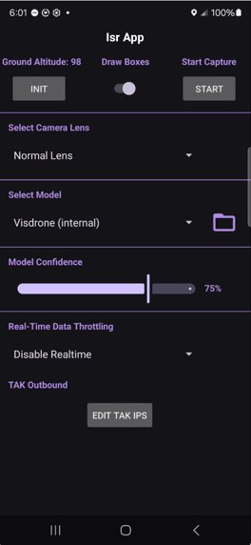
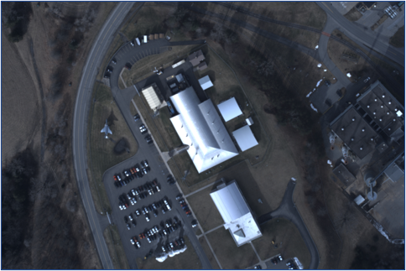
Phenom App on Drone
Edge Capabilities
Aerial imagery capture via phone camera​
Realtime onboard Automated Target Recognition
Geo-registration of imagery and geo-location and class tagging of targets​
Remote command and control
Target reporting via CoT to ATAK/XTAK​/TAK Server
Target chips-outs for low bandwidth target reporting
User Benefits
Supports custom model uploads​
KML export for map viewers, including Google Earth and purpose-built offline gallery viewer​
Searchable gallery for images and geo-data​
Configurable user interface​
Target Chip-out Gallery
Configuration Menu

